Slide 1

SubReddit Classification
Using webscraping, NLP & classification ML techniques
Done by Ethan Lee
13 Aug 2022

Slide 2

Agenda
1. Define the problem
2. Gather & clean the data
3. Explore the data
4. Model the data
5. Evaluate the model
6. Answer the problem

Slide 3
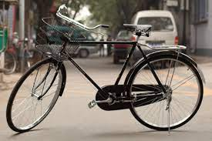
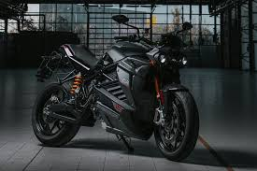
Problem statement
How well can we classify a post belonging to one of two popular subreddits:
/r/bicycling
1.1m subs
/r/motorcycles
1.5m subs
Reason for choosing these 2 subreddits:
Large number of subs = likely higher quality posts
Similar (as a mode of transport, mostly 2-wheeled, used for sports etc) but different
Problem Statement
Gather & Clean Data
Explore Data
Model Data
Evaluate Model
Answer the Problem

Slide 4


Data gathering & cleaning
Gathered 3,000 posts per subreddit
Data cleaning:
Joined title and selftext (many empty self texts)
Removed duplicates
Removed urls, special characters, emojis
After cleaning, 5,329 posts left
53.5% bicycling and 46.5% motorcycles
Title
Selftext
Problem Statement
Gather & Clean Data
Explore Data
Model Data
Evaluate Model
Answer the Problem

Slide 5
Preprocessing and EDA
Stop words removal
Added stopwords such as “bicycle, motorcycle, motorbikes, cyclist” to the original list of “English” stopwords
Porter Stemming
Used to extract the base form of the words by removing affixes
E.g. apartment -> apart, garage -> garag, preventing -> prevent
Lemmatizer
Grouping together different forms of the same word
E.g. riding-> ride, rides -> ride, rider-> ride
Problem Statement
Gather & Clean Data
Explore Data
Model Data
Evaluate Model
Answer the Problem

Slide 6
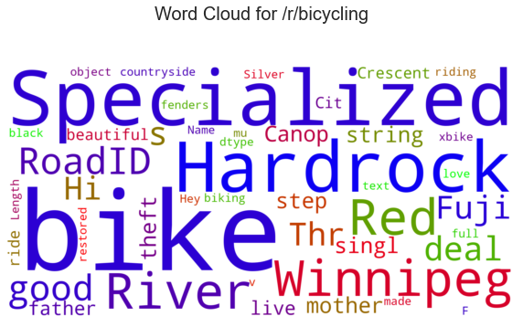
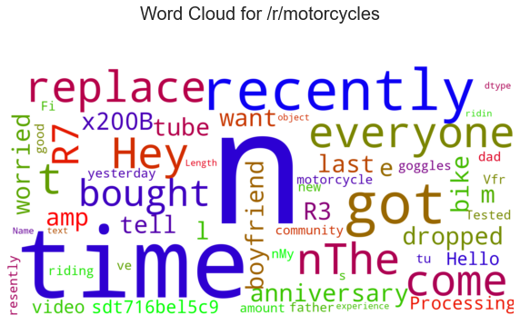
Preprocessing and EDA
WordCloud to visualise common words
N-grams
Continuous sequence of words in a document
E.g. First bike, brand new, need help
Bigrams more common that tri-grams, and mostly associated with people asking for advice or help
Problem Statement
Gather & Clean Data
Explore Data
Model Data
Evaluate Model
Answer the Problem

Slide 7
Modelling
Train-test split done on 3 datasets (cleaned tokens, stemmed tokens and lemmatized tokens)
Train size 70%, test size 30%
4 models:
CountVectorizer with MultinomialNB
TfidfVectorizer with MultinomialNB
CountVectorizer with RandomForest
TfidfVectorizer with RandomForest
Model 1
Tokens
Model 2
Stems
Compare results
Model 3
Lems
Model 4
Problem Statement
Gather & Clean Data
Explore Data
Model Data
Evaluate Model
Answer the Problem

Slide 8
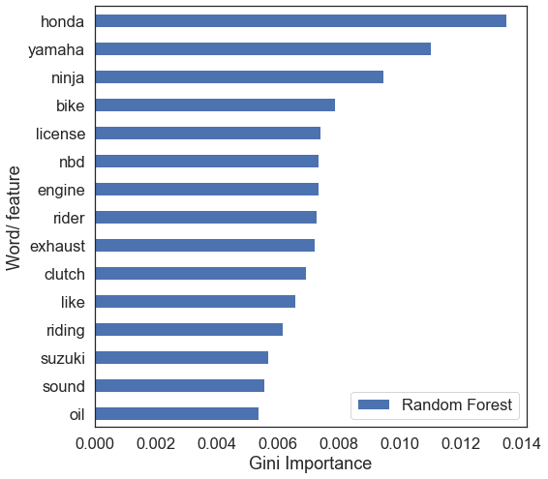
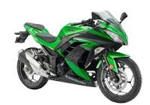
Feature Importance
Higher score means that the feature will have a larger effect on the model prediction
Words used to distinguish motorcycles from bicycles
Brands: Honda, Yamaha, Ninja, Suzuki
Motorcycle-specific words: Clutch, engine, exhaust, oil
Problem Statement
Gather & Clean Data
Explore Data
Model Data
Evaluate Model
Answer the Problem

Slide 9
Model Evaluation
Compare on accuracy, generalisation, precision, f1 score and AUC ROC score (since dataset in fairly balanced)
 | Accuracy | Generalisation | Precision | F1 score | AUC ROC score
CountVect with NB | 0.8737 | 6.49% | 0.8455 | 0.8677 | 0.9465
TfidfVect with NB | 0.8699 | 9.11% | 0.8534 | 0.8613 | 0.9522
CountVect with RF | 0.8418 | 15.6% | 0.8375 | 0.8278 | 0.9111
TfidfVect with RF | 0.8443 | 15.3% | 0.8479 | 0.8286 | 0.9138
Problem Statement
Gather & Clean Data
Explore Data
Model Data
Evaluate Model
Answer the Problem

Slide 10
Model Parameters
Max features: 7,000 (Only top 7000 words from corpus saved)
Max df: 0.95 (Ignore words that occur in >95% of documents from corpus)
Min df: 2 (Word must occur in at least 2 documents from corpus)
Ngrams: (1,2) (Capture every 1 and 2 word phrases)
Stopwords: ‘english’ + common words like ‘bicycles, motorcycles, cyclists’ etc
 | Accuracy | Generalisation | Precision | F1 score | AUC ROC score
CountVect with NB | 0.8737 | 6.49% | 0.8455 | 0.8677 | 0.9465
Problem Statement
Gather & Clean Data
Explore Data
Model Data
Evaluate Model
Answer the Problem

Slide 11
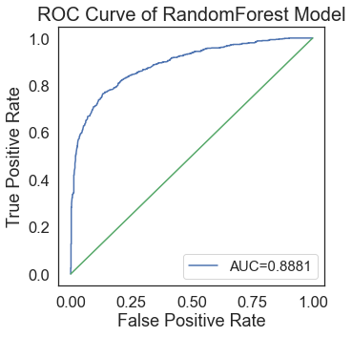
Model Evaluation
CountVectorizer with MultinomialNB was chosen because of its good generalization, accuracy, precision, F1 score and AUC ROC score
Not as overfitted as the Random Forest models
Takes lesser time to run (9 seconds) compared to the RandomForest model (28 seconds)
0.9465
 | Accuracy | Generalisation | Precision | F1 score | AUC ROC score
CountVect with NB | 0.8737 | 6.49% | 0.8455 | 0.8677 | 0.9465
Problem Statement
Gather & Clean Data
Explore Data
Model Data
Evaluate Model
Answer the Problem

Slide 12
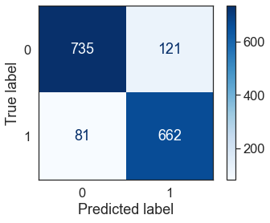
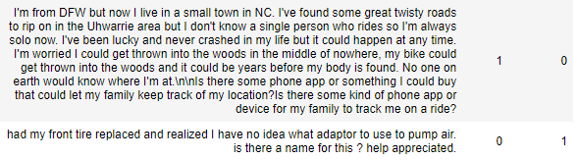
Answering the Problem
How well can we classify a subreddit post?
87% accuracy, but possible to increase the accuracy and precision of the models using GridSearch instead of Randomized Search (only 25 iterations done in model)
Actual
Predicted
Problem Statement
Gather & Clean Data
Explore Data
Model Data
Evaluate Model
Answer the Problem

Slide 13
Conclusion
Model performed ok despite some spam posts left over. More thorough cleaning can be done to remove more spam
Test out on other models other than Naive Bayes and Random Forest
Explore new features within Reddit such as the upvotes and downvotes, as well as post comments
Metrics are easy to compare for a balanced dataset. In the future, need to make use of sensitivity and specificity for imbalance datasets. The ROC-AUC curve would also have to be substituted with the Precision Recall curve.

Slide 14
Q&A
Any questions? Thank you!

Slide 15
Appendix
Random Forest seemed to overfit, generalization is not good.
Current hyperparameters tested
N_estimators: [100, 150, 200]
Max_depth: [None, 1, 3, 5]
How to improve?
Reduce number of variables sampled at each split (reduce max_features)
Use more data
Increase the number of n_estimators
Use other hyperparameters such as min_samples_leaf (set >1)

